Slide 1
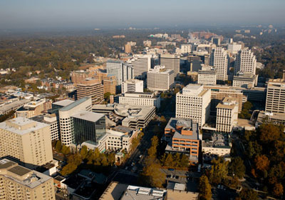
Academic Honesty and Copywrite in the MYP
Chris Stephenson
Notes:
The following slides should be used by all workshop leaders as a template. Please be mindful of using images that do not violate copyright laws. I am using the sanctioned template for the International Baccalaureate Middle Years Programme / Diploma Programme for Workshop Leaders. This presentation will become useful when teaching teachers about the ideas behind Academic Honesty and copy write – a requirement in leading a CAT 1 and 2 teacher professional development workshop. The context is delivery to IB students and teachers – so that the student better understands what is copy write v fair use in their academic work in the context of academic honesty

Slide 2
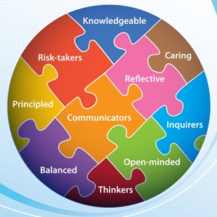
Academic Honesty/Copywrite/Fair Use
Academic Honesty | Copy Write | Fair Use Policy
 | ©
Notes:
Define the three areas and clarify what each one of these areas means
Academic Honesty: Principled IB learners should “act with integrity and honesty with a strong sense of fairness, justice and respect” (The IB Learner Profile Booklet (2008) (p.5)
Copywrite: The exclusive legal right to reproduce, publish, sell or distribute the matter and form of something (such as literary, musical or artistic work) (Websters)
Fair Use Policy: A legal document that portions of copywrited materials may be used without permission of copywrite owner provided that use is fair and reasonable, does not substantially impair the value of the materials and does not curtail the profits reasonably expected by the owner. (Websters)

Slide 3
PLAGIARISM
Plagiarism is representing someone else’s ideas, words, statements, or other work as one’s own without proper acknowledgment or citation.
Notes:
Students understand the ideas behind the use of copy written material in their own work and what they can and cannot use in the scenarios that follow. That this is a legal infringement and in a data rich world where it’s easy to extract information for work that students are doing, it needs to be authentically used in the context of the task set for their learning, developing skills of analysis and comprehension

Slide 4
Ignorance is no excuse!
Extended Essay
Creativity, Action Service
Internal Assessment - Geography
Notes:
The following scenarios are common in IB students – this is to help them understand what they can use in context (fair use) and what they cannot (copywrite law violation) in key areas of their academic work – Extended Essay, Creativity, Action and Service (CAS) and Internal Assessment in Geography

Slide 5
Why is it important that I know this?
Threatens the value of IB accreditation
And failure to deal with dishonesty, however rare, would threaten IB standards
It’s a big deal!
IB learners are constructivist learners
Notes:
The number of cases involving dishonesty is tiny compared to the number of authentic assessments completed by IB learners around the world (the IB does not make public the number and nature of academic dishonesty cases). However, each contravention of IB principles requires effective management as dishonesty threatens the value of IB accreditation and failure to deal with dishonesty, however rare, would threaten IB standards.

Slide 6
Scenario 1 - Extended Essay
My essay is about the Millennium Development Goals (MDG) and I want to use large parts of the MDG 2013 report in my essay, as it is written in the report. That’s fair use, right?
Notes:
A common scenario for the IB supervisory teacher in both the MYP (Personal Project) and DP. An Extended Essay is a 4,000 word research paper undertaken by the student in the context of their own research question and answers around that.

Slide 7
Scenario 1 – Extended Essay
Click here to understand what you can and cannot do!
Size matters!
Use it in an analytical way!
Notes:
Movie talks to what a student can extract from scholarly articles or other items of research that they may be doing as part of the Diploma Programme.
“This factor considers how much of the copyrighted work was used in comparison to the original work as a whole. Generally, the larger the amount used, the less likely a court will find the use to be a fair use. Amount and substantiality is also a qualitative test; that is, even though one takes only a small portion of a work, it still may be too much if what is taken is the "heart of the work”. (http://www.copyright.com)
Size matters: The amount and substantiality of the portion used in relation to the copyright-protected work as a whole
Use it in an analytical way! Fair use is only valuable when components of the information are used in an analytical way

Slide 8
Scenario 2 – Service Video
My video is about the by volunteering at the food back and I want to use the music from “The Script-Standing in the Hall of Fame” as part of the evidence montage
Notes:
A common scenario for the Creativity, Action, Service programme. Students have to provide evidence of their participation in volunteering. Students in DP programme have to perform 150 hours of documented creativity, action and service hours as part of their Diploma Programme.
Up to 10 percent of a copyright musical
composition may be reproduced,
performed, and displayed as part of a
multimedia program produced by an
educator or students.

Slide 9
Scenario 2 – Service Video
Only up to 10% of the song!
Presentation
By educator or students
Notes:
Highlight that:
Up to 10 percent of a copyright musical
composition may be reproduced,
performed, and displayed as part of a
multimedia program produced by an
educator or students.

Slide 10
Scenario 3 – Internal Assessment Geography
My Internal Assessment Fieldwork needs to refer to secondary maps from the United States Geological Survey (USGS).
Notes:
A common scenario for Diploma Geography Students. Students need to research primary data and use with secondary data as part of their Diploma Programme internal assessment for Geography.

Slide 11
Scenario 3 – Internal Assessment - Geography
Government Maps are useful!
Free maps aren’t “copywrite” free
Notes:
Highlight that:
Students should know that maps generated by a government agency can be used but if commercial (like Google) they need to be cited correctly. Due to the current US Federal Government shutdown, it is difficult to source the material for this as most sites are not being maintained.
All maps (except some U.S. government publications) are subject to copyright, regardless of the media (print, Internet, CD-ROM, etc.). This is true of all street maps and atlases, road maps, decorative maps, perspective view maps, wall maps, locator maps, cartoon maps, and globes. Even maps acquired "for free" from AAA or a similar source, the map is still protected by copyright

