Slide 1
Data Overview for Educational Records Bureau (ERB) Testing 7th Grade Senior Management Team
April 2014

Slide 2
Why do we do these tests?
Additional tool –another kind of data to foster student differentiation and thus growth
Gives us a different lens to add to that of the IB rubrics we use
Experience taking standardized tests
School team dialogue stimulus

Slide 3
Objectives
To investigate achievement by the 7th Grade in the ERB 2013
To identify areas of weakness to further improve achievement across all objective strands ERB assessment in
Verbal Reasoning
Vocabulary
Reading Comprehension
Writing Mechanics
Writing Concepts and Skills
To investigate if lower scores in Vocabulary might be attributed to learning through second language areas in curricular areas in AIS
The mission of the ERB is: To create testing and learning solutions that would help schools develop improved curriculum, teaching and learning through diagnosis of assessment results that address essential learning standards.
Notes:
10 years – earliest records 7 years ago – context – for Independent schools and is composed of stanines – able to break down into three sectors work of above average students into three categories – which with other tests are a small percent on a bell curve. Our data is normed with public and independent schools we looked at just independent school – dual language immersion programme. Test has math, english – nt just performance – verbal reasoning…quantitative reasoning. Measures of intate intelligent – abstract relationships – potential for differentiation.
Not for just for parent communicaton – compare potential with performance – most gifted are differentiated
Statinines – 1-3 = 23% bottom 54% 4-6 stanine (average is 5 – majority) then the 7-9 – above average and a small number – so if the students are not performing in that top band then our differentiation is an issue. Still below in terms of the top level. All percentages
Can set the growth goals based on this for english and math teachers
MAP – pilot data

Slide 4
ERB Reasoning Tests
Subtle, abstract relationships expressed in words or numbers.
Measures a student’s ability to recognize logical relationships in unfamiliar contexts.
Predict Performance
Adapted from erblearn.org

Slide 5
ERB Achievement Tests
Measure what a student has learned in reading and mathematics.
Measure mastery of skills and knowledge
Snapshot of performance
Adapted from erblearn.org

Slide 6
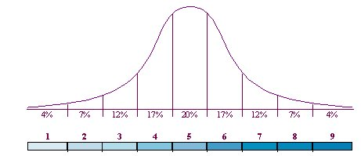
Stanines
Norm distribution curve
Stanine
Percentile Rank
Notes:
Normal distribution curve can be used to describe, at least approximately, any variable that tends to cluster around the mean. For example, the heights of adult males in the United States are roughly normally distributed. Most men have a height close to the mean (70 inches/5’8’-5’9’), though a smaller number have a height significantly above or below the mean. Male heights will appear similar to a bell curve, with the correspondence becoming closer if more data is used.
Test results giving stanines and percentiles are based to the normal distribution curve. Scores are based on performance relative to all other students in a group taking the same test and are referenced to the performance of group members. A majority fall in the middle (4,5,6) and fewer at either end.

Slide 7
Scores 2011
Percentage

Slide 8
Score 2012
Percentage

Slide 9
Scores 2013
Percentage

Slide 10
5th Grade 2011
Percentage

Slide 11
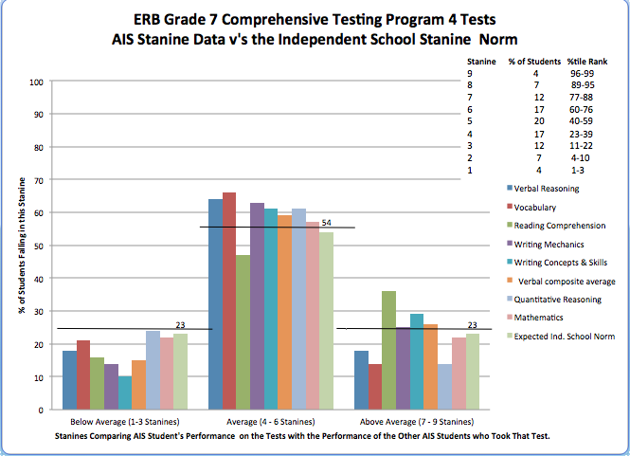

Slide 12
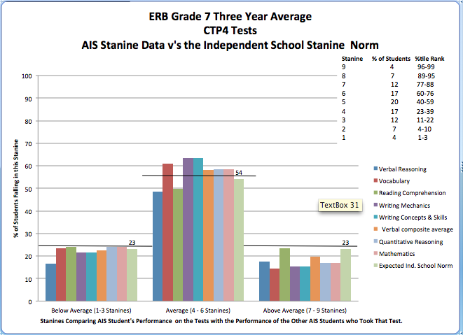

Slide 13
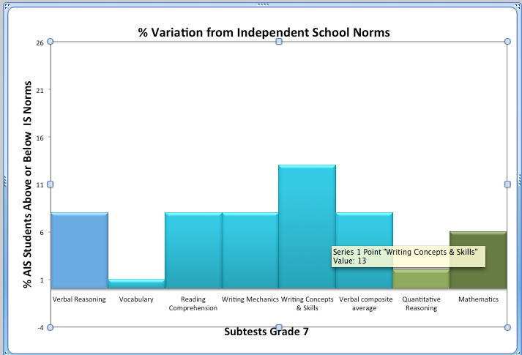

Slide 14
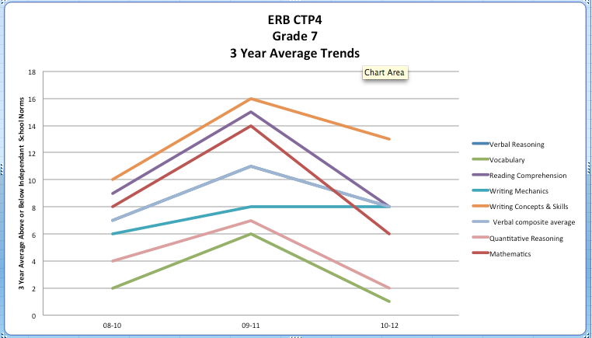

Slide 15
Strengths for ERB Data
AIS 7th Grade students perform above standard in areas of writing, concepts and skills against International norms
AIS 7th Grade students perform at standard for Reading Comprehension, Verbal Reasoning and Verbal Comprehension

Slide 16
Weakness / Improvement
AIS 7th Grade students perform below standard in Vocabulary, Quantitative Reasoning and Math
A defined area for improvement in the 2015 test has been identified as Math and Vocabulary
Interventions have been put into place for Math in 2013-14 school year
Vocabulary strategies unclear as instruction is across four different language areas and because test is in English only

Slide 17
Next Steps
How do we raise vocabulary performance across the 7th Grade in an English speaking test when 50% of our students do not speak English as a first language
How do we raise vocabulary performance in students that are instructed in their subject areas in two languages?

Slide 18
Thank You

